Slide 1

Yulee Band Parent Association, Inc
YBPA
BAND PARENTS MEETING 1/16/25 @6:00PM
Notes:
Let's get the meeting started

Slide 2
WELCOME
Evette
Band Parent Meetings: FIRST THURSDAY of every Month
Next Band Parent Meeting: Feb 6th, 2025 at 6:00pm
This Meeting’s Discussion:
Finances
Concert Season
Board Member Open-House/Elections Meeting
Universal Spring Break Trip
Shrimp Festival
Mr. Walker & Jordan Updates

Slide 3
ARE YOU CONNECTED?
Evette
REMIND APP: @ms1band
OUR EMAIL LIST: YuleeBandParentAssociation@Gmail.com
FACEBOOK: https://www.facebook.com/groups/yhsband/
WEBSITE: http://yhsband.com
SOCIAL MEDIA: Facebook @YuleeBandParentAssociation
Ask a Board Member! Amanda, Jenn, Scott, Melody, Jason, or Evette

Slide 4
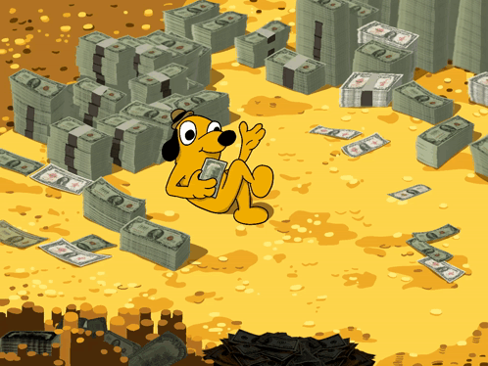
Finances
Jason

Slide 5
FINANCES
Jason
Balance November 30: $61,602.44
Income Summary ($16,855.41): Spring Break Payments($2050.00 checks/$3,685.59 Paypal), Nassau Percussion Fair Share($4,412.50 checks/$6,458.36 Paypal), Purchases of MS1 Swag ($98.90), Donation ($150.00)
Expense Summary ($13,237.92): Band Staff Fall Grant ($11,750.00), Pizza ($210.00), Nassau Percussion Uniforms ($1071.50), Admin Fees ($172.00)
Balance December 31: $65,219.93
Current Balance (January 16, 2025): $90,990.05
Upcoming expenses: Nassau Percussion, SHRIMP FESTIVAL

Slide 6


Slide 7
Concert Season Schedule
Jenn
2/28: Concert MPA @ First Coast HS
2/14-2/15: Solo and Ensemble
2/20: Pre MPA @ FBMS
3/14-3/17: Spring Break Trip Orlando - Universal
  Dates shifting to 3/15-3/18
5/2 - 5/4: SHRIMPFEST 2025
Tentative May Date for Band Banquet & Boco (combined event)

Slide 8

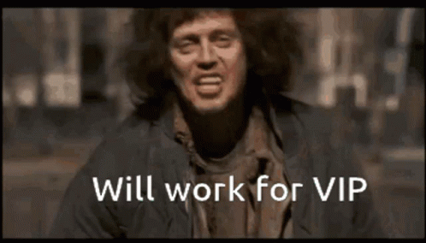
NEXT GEN
BOARD MEMBERS
Evette

Slide 9
Board Member
Evette
Be an important part of making memorable experiences for band students
Continue the Amazing Band culture.
Bring Fresh Ideas
Etc
Recruitment

Slide 10
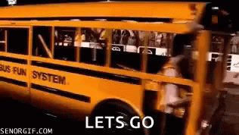
Spring Break
Evette

Slide 11

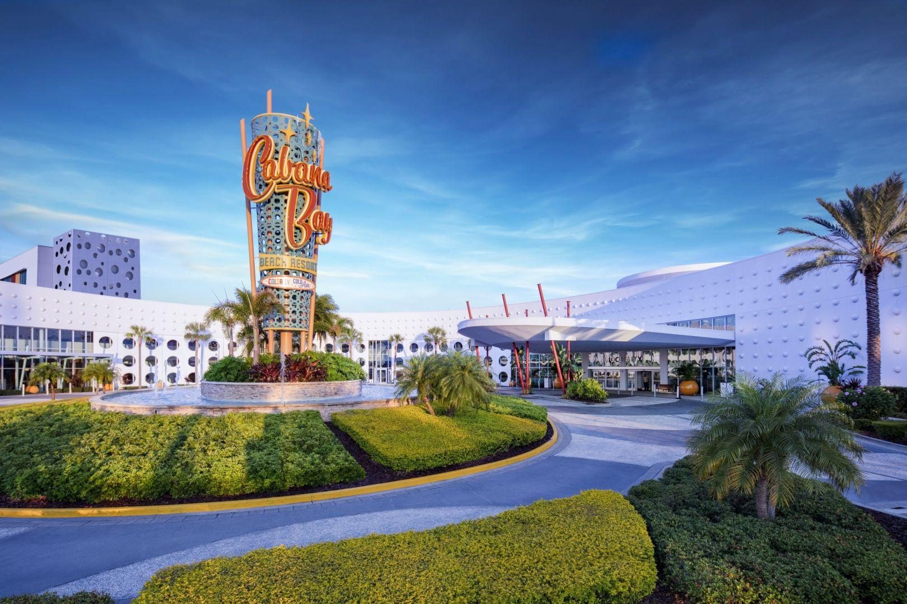
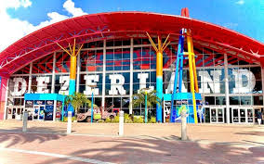
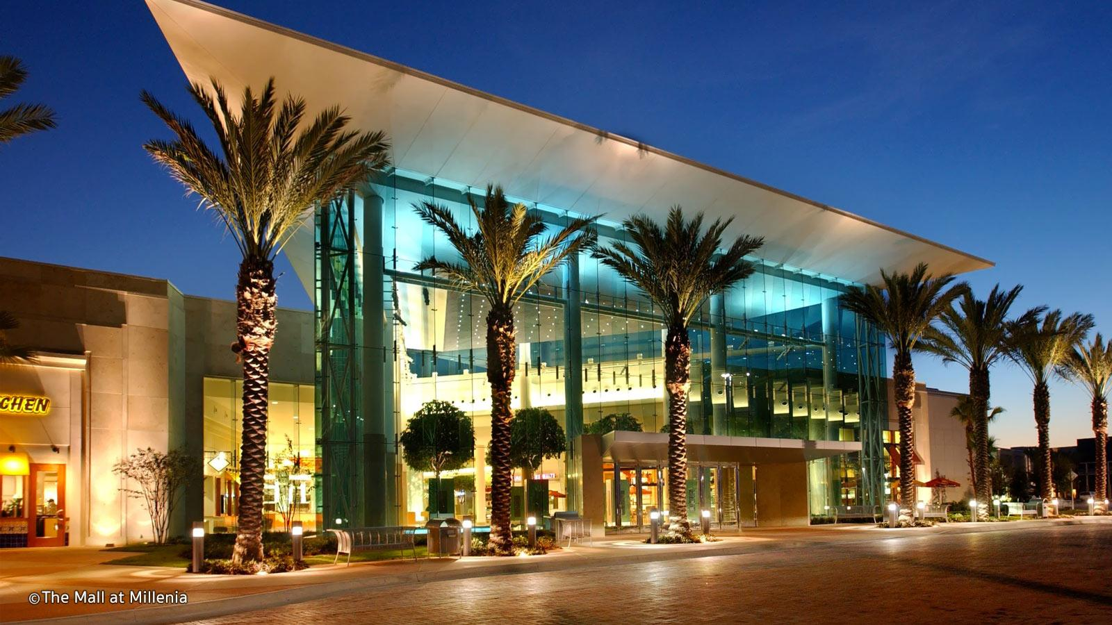
Evette
Spring Break 2025 - Orlando, FL
March 15 - 18th - NEW DATE CHANGE
Overnight Trip!!!
Expected cost
Includes: Hotel, Breakfast,
Transportation, & Activities $48,500
Cost Per Student: $600
Student cost must be paid online or via check made out to Yulee Band Parent Association no later than Jan 10th

Slide 12

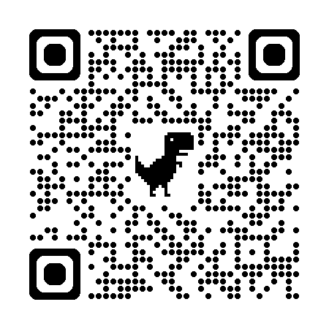
Shrimp Festival Planning
Jason

Slide 13
Shrimpfest Important Info
Jason
Sign up for committee
Dates:
    May 2, 2025 - May 4, 2025 Shrimp Festival
    Feb 2025 - Meeting at Blackrock Baptist Church
Goal :
    Weekly meetings February and March for planning / Less frequent in April
    Division of planning/coordination task
    Pass along knowledge
    Social Fun
Volunteers (Parents & Students)
Etc

Slide 14
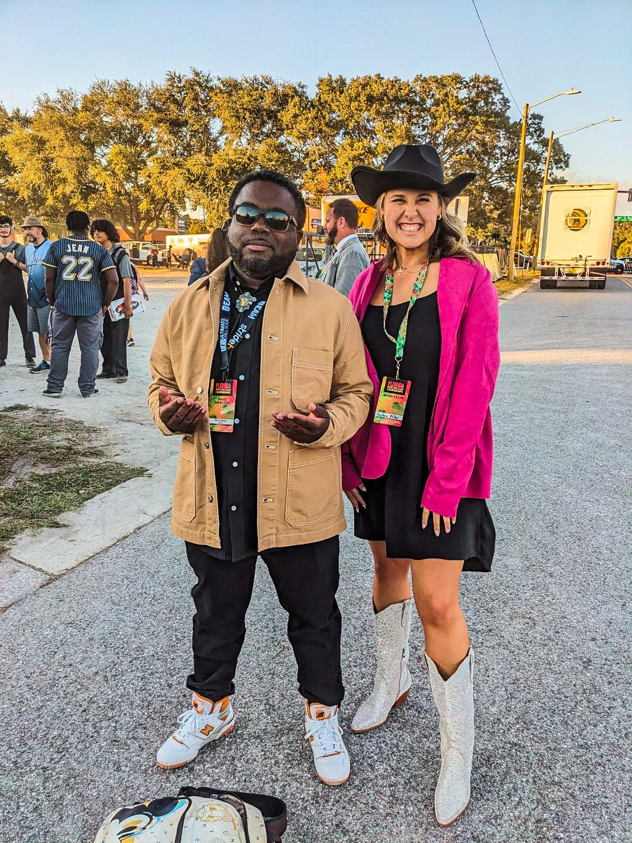
Mr. Walker &
Ms. Jordan

Slide 15
Volunteer
Info/Link
Or on our website YHSBand.com
Evette

Slide 16

QUESTIONS???
Evette

