Slide 1
Yulee Band Parent Association, Inc
YBPA
BAND PARENTS MEETING 12/5/24 @6:00PM
Notes:
Let's get the meeting started

Slide 2
WELCOME
Evette
Band Parent Meetings: FIRST THURSDAY of every Month
Next Band Parent Meeting: Jan 9th or 16th, 2025 at 6:00pm
This Meeting’s Discussion:
Finances
Concert Season
Upcoming Events
Band Spring Break Trip
Fundraising Events
Mr. Walker & Jordan Updates

Slide 3
ARE YOU CONNECTED?
Evette
REMIND APP: @ms1band
OUR EMAIL LIST: YuleeBandParentAssociation@Gmail.com
FACEBOOK: https://www.facebook.com/groups/yhsband/
WEBSITE: http://yhsband.com
SOCIAL MEDIA: Facebook @YuleeBandParentAssociation
Ask a Board Member! Amanda, Jenn, Scott, Melody, Jason, or Evette

Slide 4
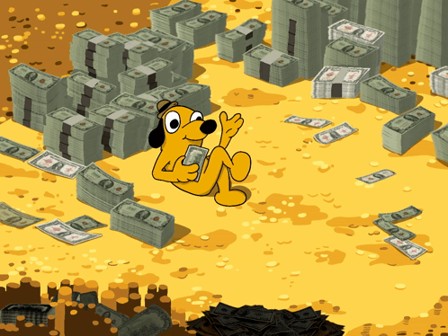
Finances
Jason

Slide 5
FINANCES
Jason
Balance October 31: $62,177.94
Income Summary ($4,989.76): Band Spring Break Trip payments, Sale of Band Show Shirts and Hoodies, and Nassau Percussion Fair Share
Expense Summary ($5,565.26): Nassau Percussion Uniform and Custom Floor ($3,366.25), U-Haul Rental ($760.70), Color Guard FFCC Outdoor Championships ($337.70)
Balance November 30: $61,602.44
Upcoming expenses: Christmas Parade supplies, Nassau Percussion, SHRIMP FESTIVAL

Slide 7
Schedule of Upcoming Events
Amanda
12/12: YHS Winter Concert Performance @7pm. (CALL TIME: Immediately After School)
12/13: Jazz Band Dickens Performance @6:30pm: (CALL-TIME 5:30pm)
12/14: Yulee Holiday Parade & Festival (Call-Time TBD. + Concessions Booth)
3/8: Rhythm & Rides Poker Run and Afterparty Fundraiser
3/14-3/17: Spring Break Trip Orlando - Universal
5/2 - 5/4: SHRIMPFEST 2025

Slide 8
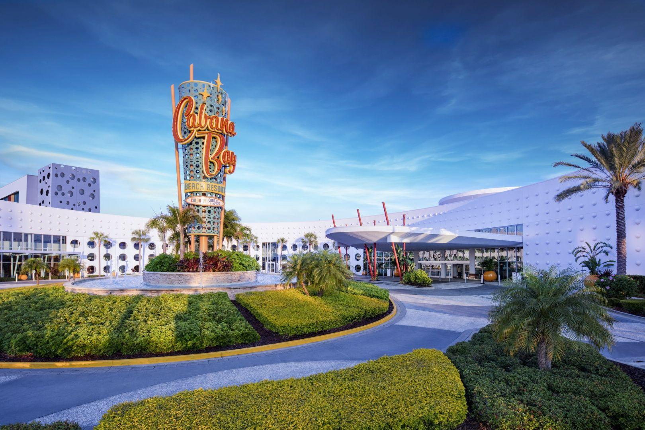
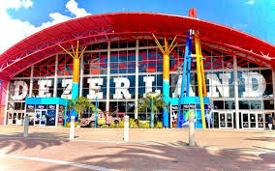
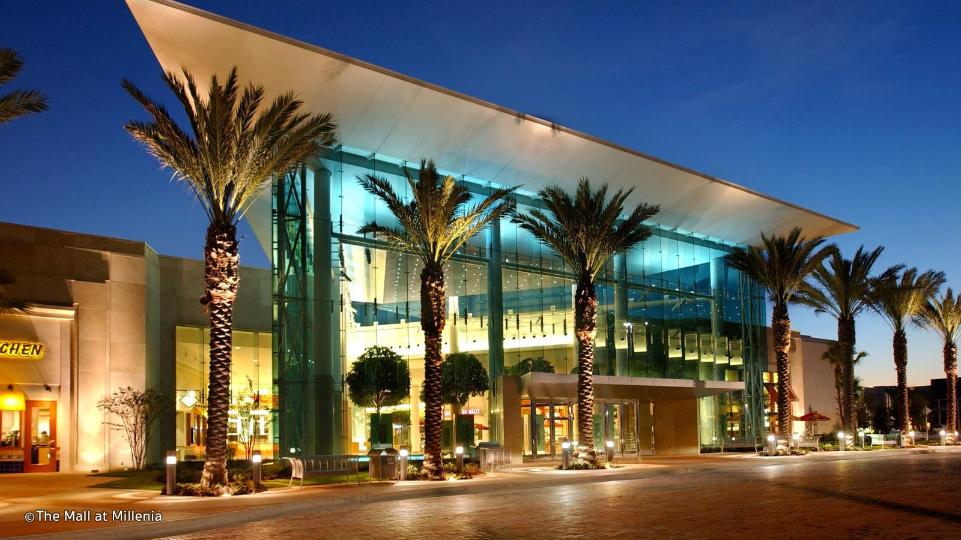
Evette
Spring Break 2025 - Orlando, FL
March 14 - 17th - Overnight Trip!!!
Expected cost
Includes: Hotel, Breakfast,
Transportation, & Activities $48,500
Cost Per Student: $600
Student cost must be paid online or via check made out to Yulee High School no later than Jan 10th

Slide 9
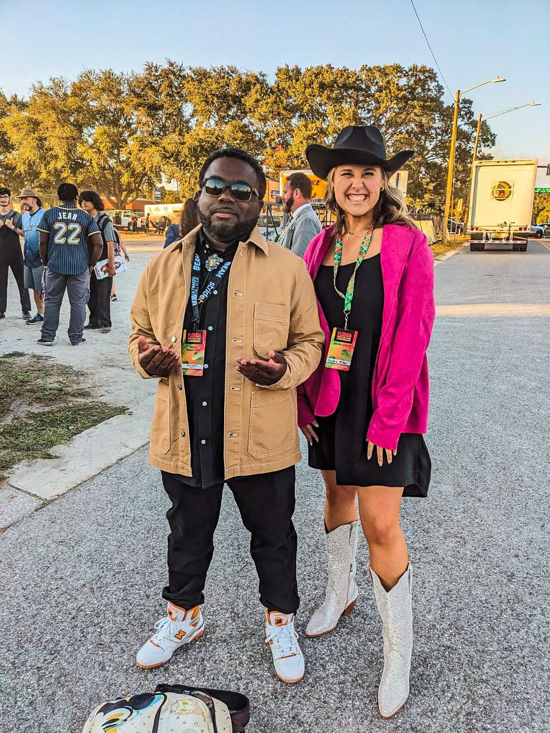
Mr. Walker &
Ms. Jordan

Slide 10
Committees
Planning Committee
Poker Run Committee
ShrimpFest Committee
Sponsorship Committee
Fundraising Committee
YBPA Board

Slide 11
Volunteer
Info/Link
Or on our website YHSBand.com
Evette

Slide 12
QUESTIONS???
Evette

